Slide 1
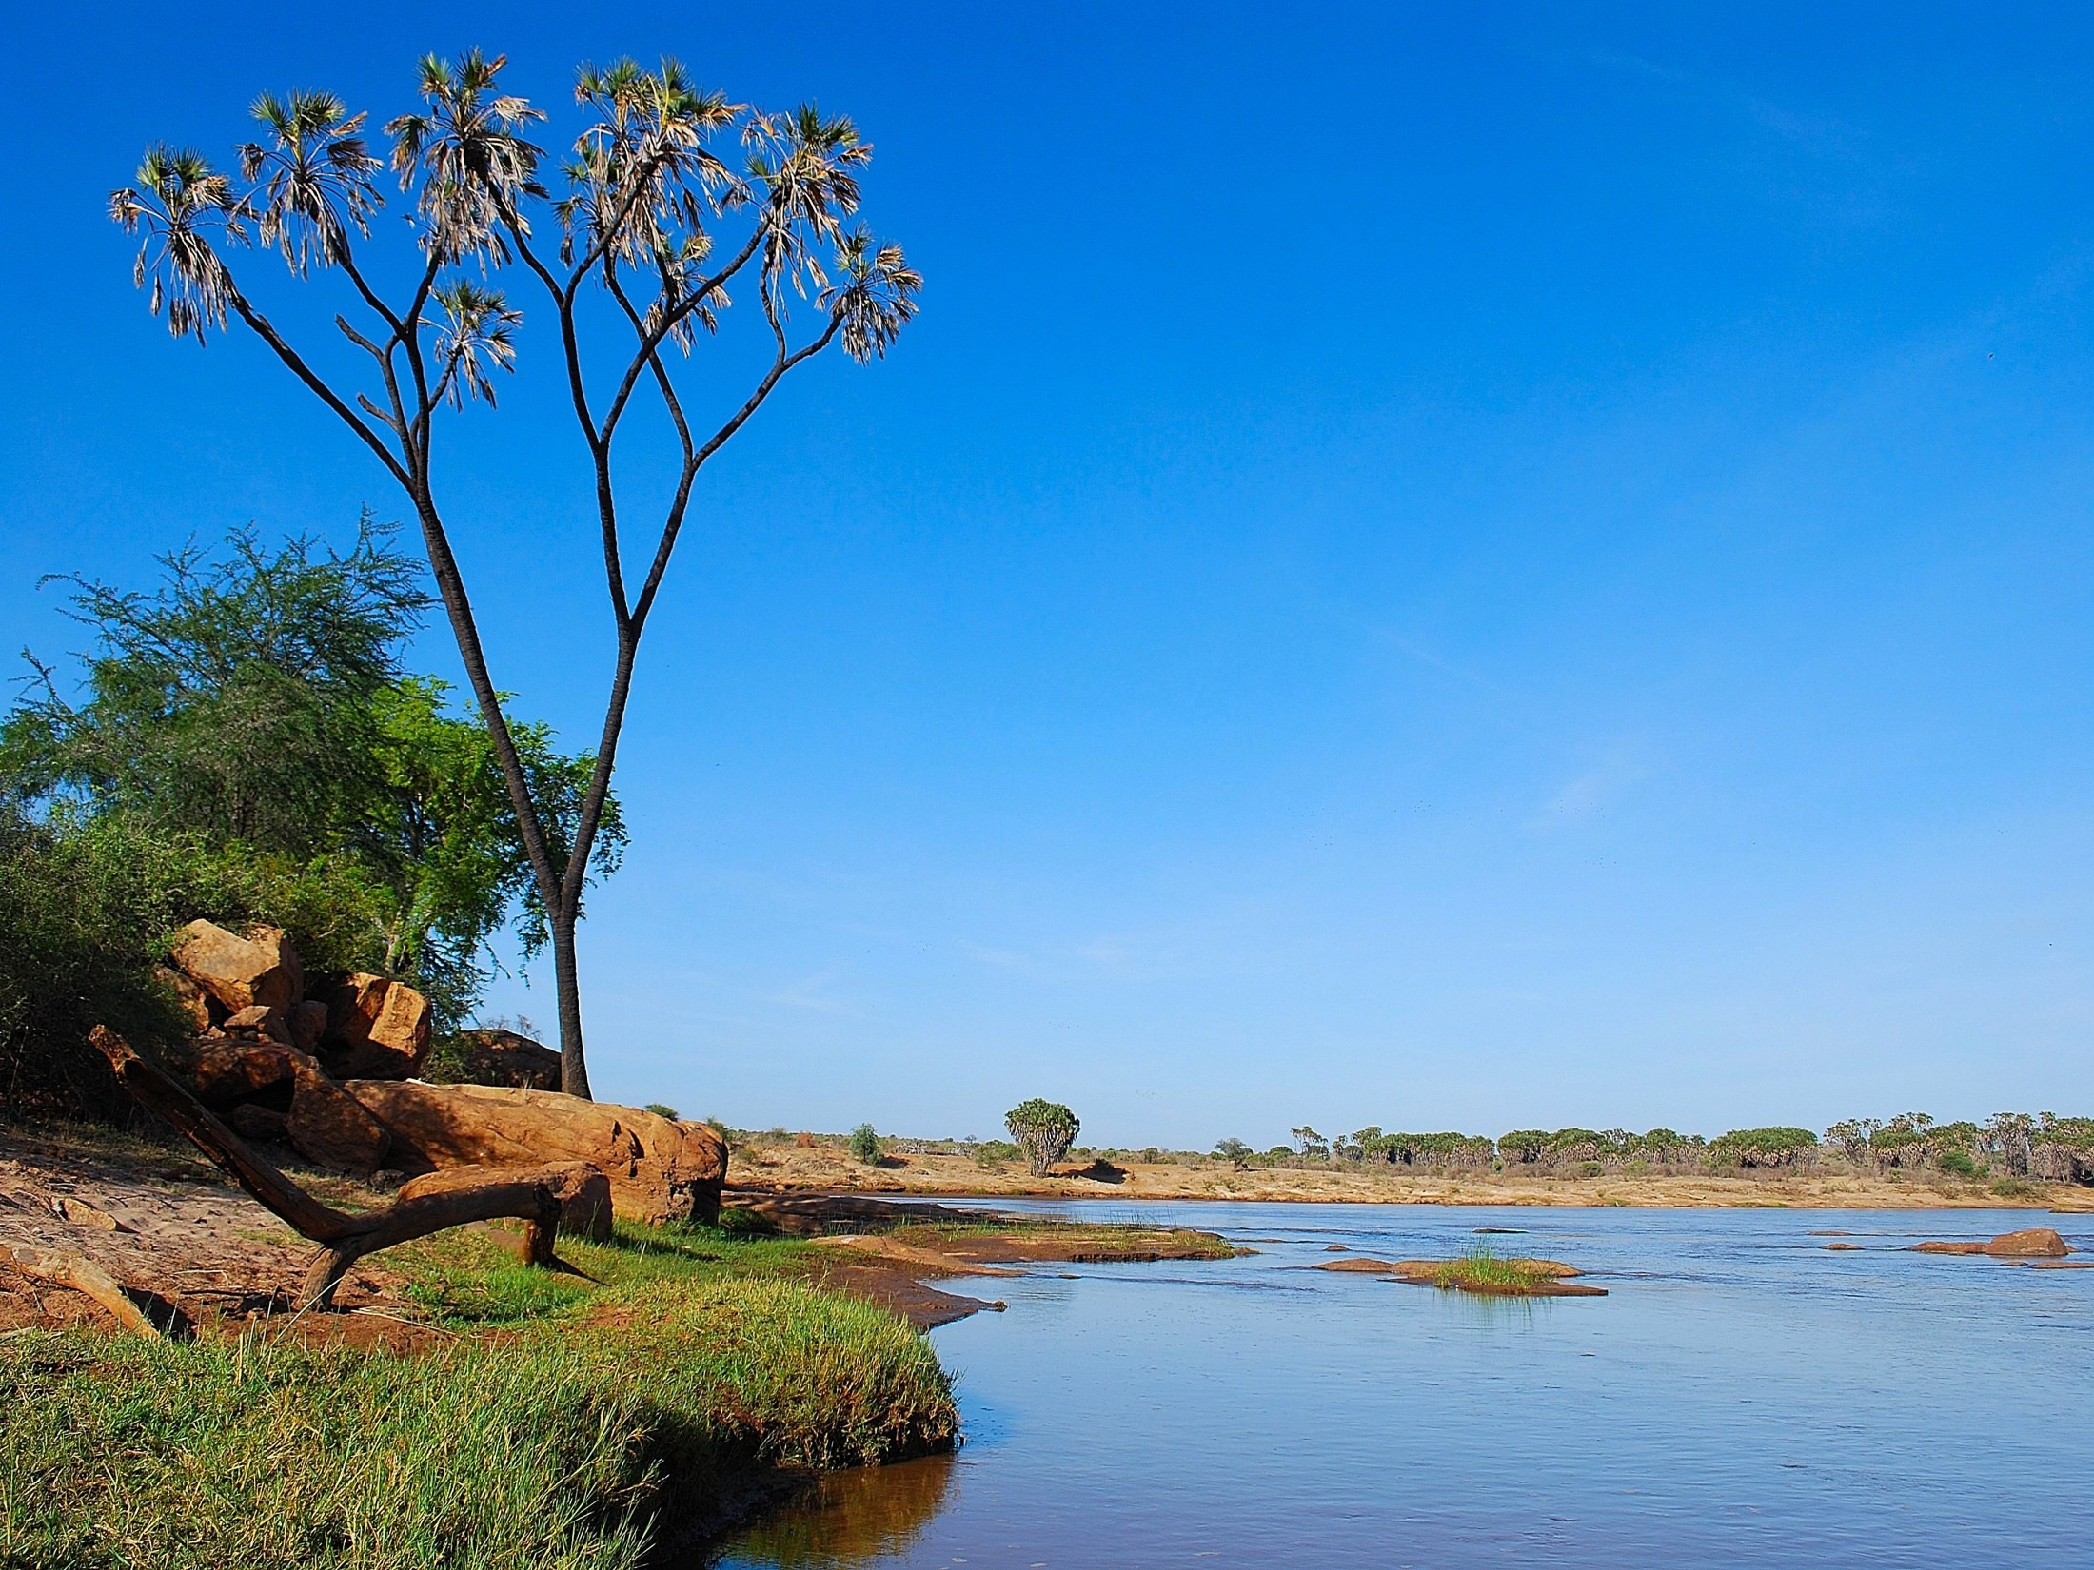
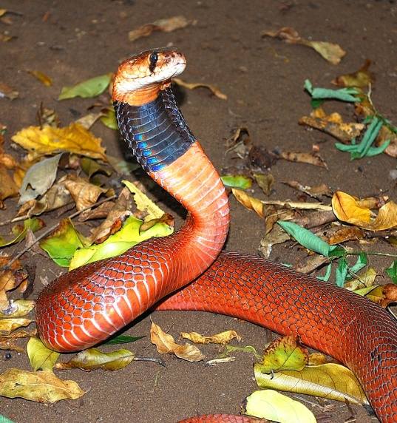
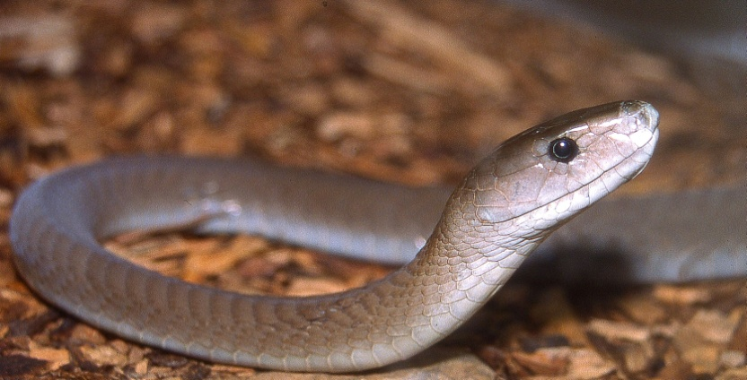
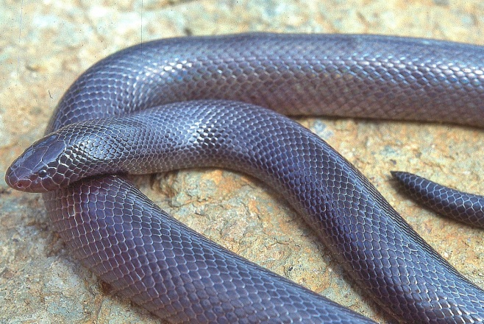
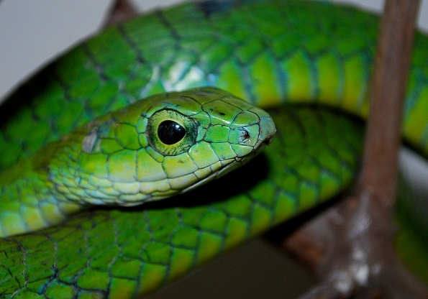
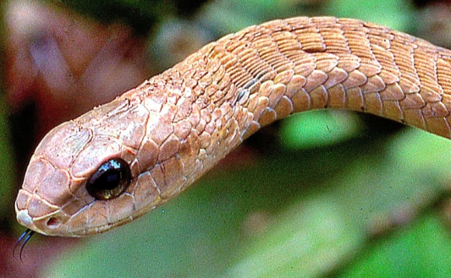
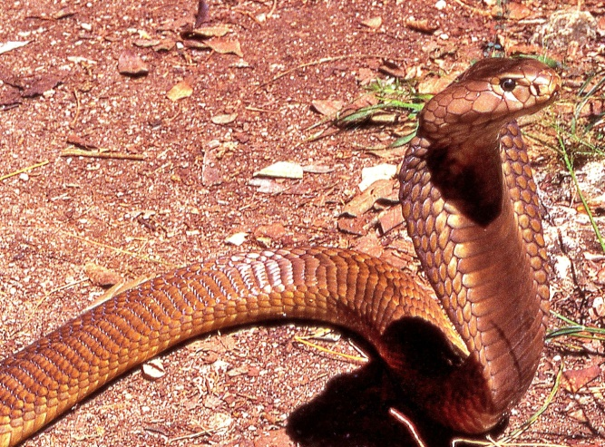
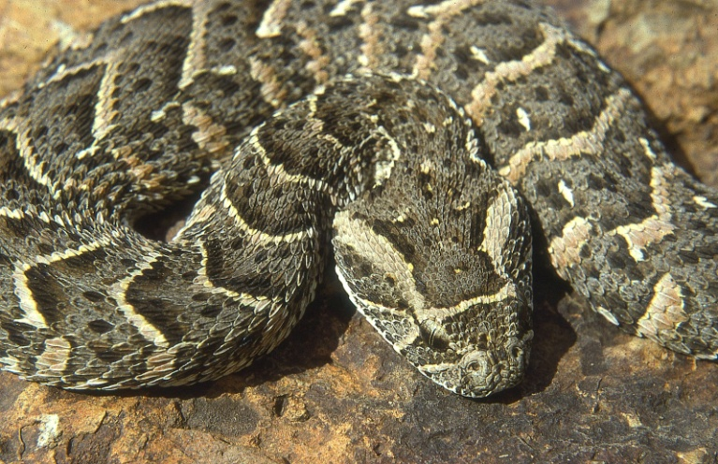
Dangerous Snakes of Tsavo
Red spitting cobra, Naja pallida
Black mamba Dendroaspis polylepis
Small-scaled burrowing asp Atractaspis microlepidota
Boomslang Dispholidus typus
Large brown spitting cobra Naja ashei
female
male
Puff adder Bitis arietans
Specimens can be donated to and identified at the Herpetology Section, National Museum, Nairobi.
Copies of this poster can be obtained from stevespawls@hotmail.com or downloaded free, from www.kenyareptileatlas.com

